Slide 1

PET SHOP
BY:
B.NANDINI
P.LALITHA
T.AKHILA
T.KEERTHI
V.N.L.R. DEEPIKA

Slide 2

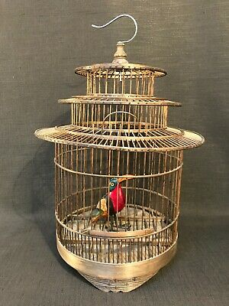

ABOUT PET HOUSE
Our website provides: shelter,food,health,toys,cleaning,accessories,beds and blankets,bowls and feeding accesorise,clothing and shoes,vitamins and wellness,grooming supplies,snacks and treat,odour remover,monitoring and control,cages and stands,aquarium technology,decoration,gravel and sand .

Slide 3

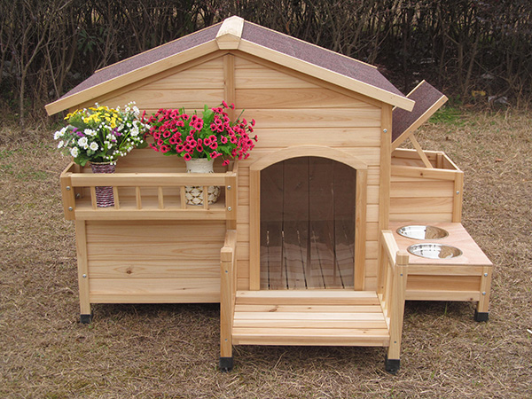
MODULES
Home
About us
Services
Login
Register
TECHNOLOGIES
HTML
DJANGO
CSS
BOOTSTRAP
MYSQL
PYTHON

Slide 4
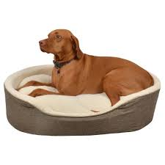
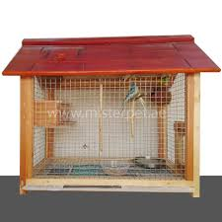

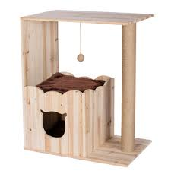
DATA BASES:
REGISTER:
First name = varchar(30)
Last name = varchar(30)
Gmail = varchar(30)
Password = varchar(30)
Verify Password = varchar(30)

Slide 5

LOGIN:
Gmail = varchar(30)
Password = varchar(30)
ADDRESS:
Name = varchar(30)
Area = varchar(30)
Contact no = int
Email = varchar(30)
district = varchar(30)

Slide 6


Slide 7


